Slide 1
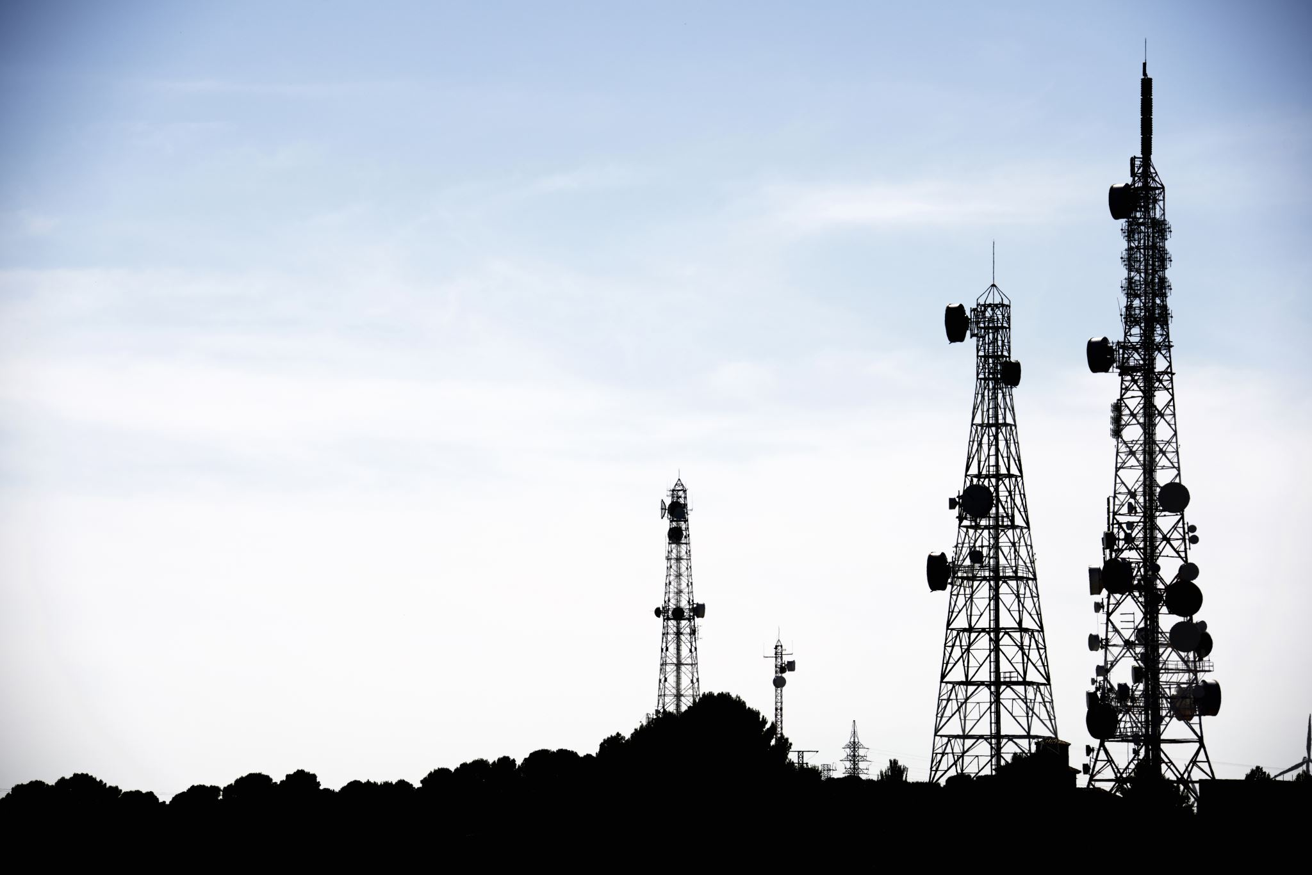
Transmission Media

Slide 2
Introduction
In transmission, media is the way the systems are connected to route data signals in a network.
The electrical or optical signals are transmitted through either copper or fiber-based transmission media.
In a copper cable network, bits are available in the form of electrical signals, whereas in a fiber network, bits are available in the form of light pulses.
The parameters of the medium and signal can be used to determine the quality and characteristics of data transmission.
Delay, bandwidth, maintenance, cost, and ease of installation are all characteristics of various transmission media.

Slide 3
Introduction
The use of long-distance communication using electric signals started with the invention of the telegraph by Morse in the 19th century.
Communication by telegraph was slow and dependent on a metallic medium.
Extending the range of the human voice became possible when the telephone was invented in 1869.
Telephone communication also needed a metallic medium to carry the electric signals, a result of a conversion from the human voice.
Wireless communication started in 1895 when Hertz was able to send high frequency signals.

Slide 4
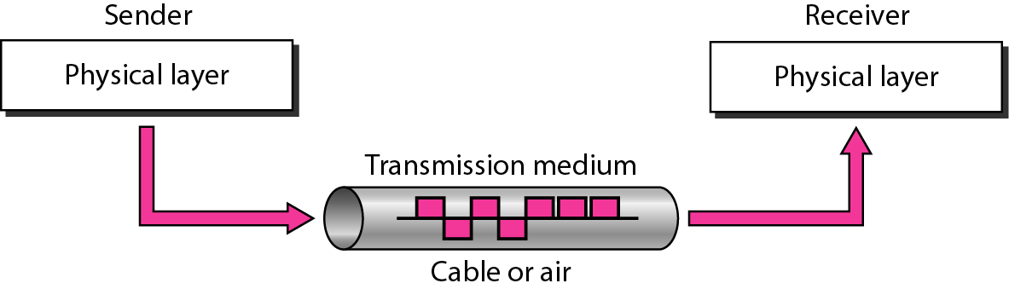
Introduction
Better metallic media have been invented (twisted-pair and coaxial cables).
The use of optical fibers has increased the data rate incredibly.
Free space (air, vacuum, and water) is used more efficiently

Slide 5
Introduction
Transmission medium can be guided or unguided.
Both guided and unguided are used for short distance (LANs, MANs) as well as long distance (WANs) communication.
Both mediums are different, but their motive is to transfer the signals.

Slide 6
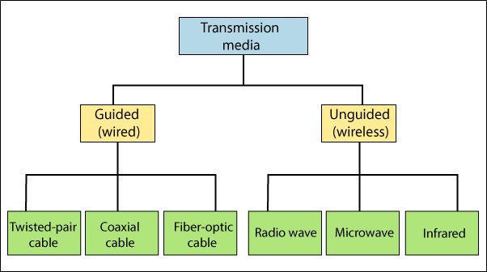
Transmission Media Classification

Slide 7
Guided Media
It provides a conduit from one device to another, include twisted-pair cable, coaxial cable, and fiber-optic cable.
Twisted-pair and coaxial cable use metallic (copper) conductors that accept and transport signals in the form of electric current.
Optical fiber is a cable that accepts and transports signals in the form of light.
A signal traveling along any of these media is directed and contained by the physical limits of the medium.
One of the most prominent aspects of Guided Media is its fast transmission velocity.
Other reason is transmission security within a limited geographical area.

Slide 8
Guided Media: Disadvantages
Bandwidth is very low in guided media.
Susceptible to interference and noise- (Noise is an electrical disturbance that can degrade communication).
High maintenance and installation costs.

Slide 9
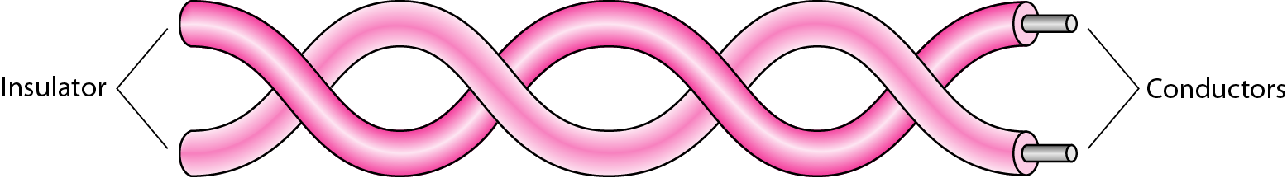
Twisted-Pair Cable
A twisted pair consists of two conductors (normally copper), each with its own plastic insulation and twisted together.

Slide 10
Twisted-Pair Cable
One of the wires is used to carry signals to the receiver, and the other is used only as a ground reference.
In addition to the signal sent by the sender on one of the wires, interference (noise) and crosstalk may affect both wires and create unwanted signals.
If the two wires are parallel, the effect of these unwanted signals is not the same in both wires because they are at different locations relative to the noise or crosstalk sources (e.g., one is closer and the other is farther).
By twisting the pairs, a balance is maintained.
Twisted Pair cable can be shielded or unshielded.

Slide 11
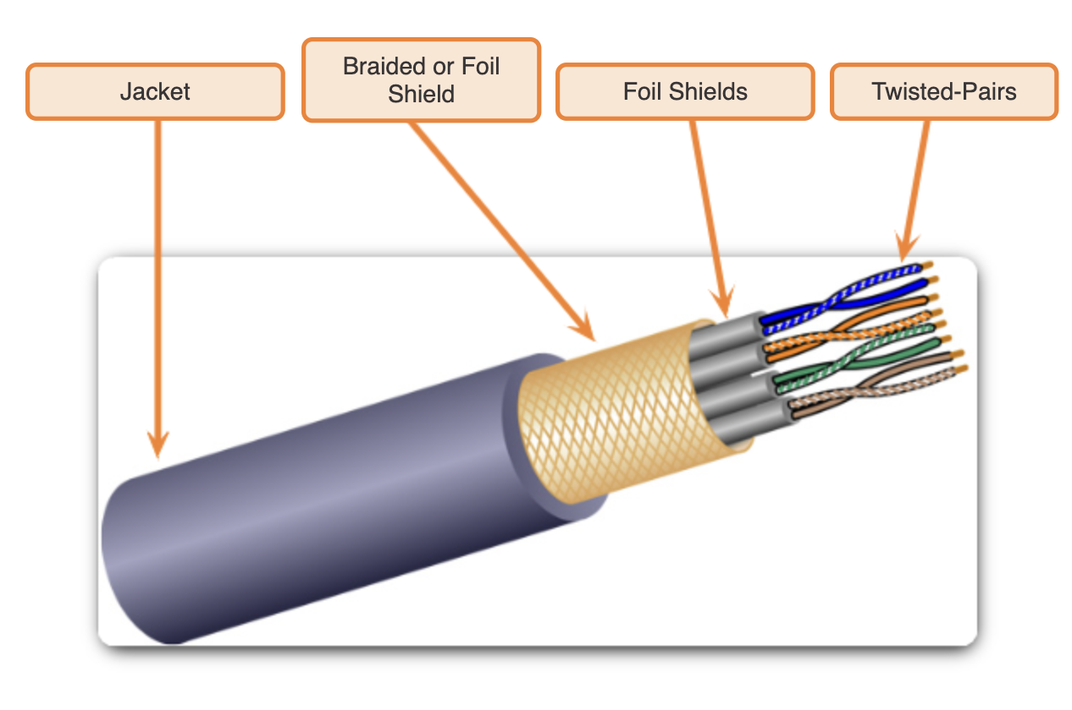
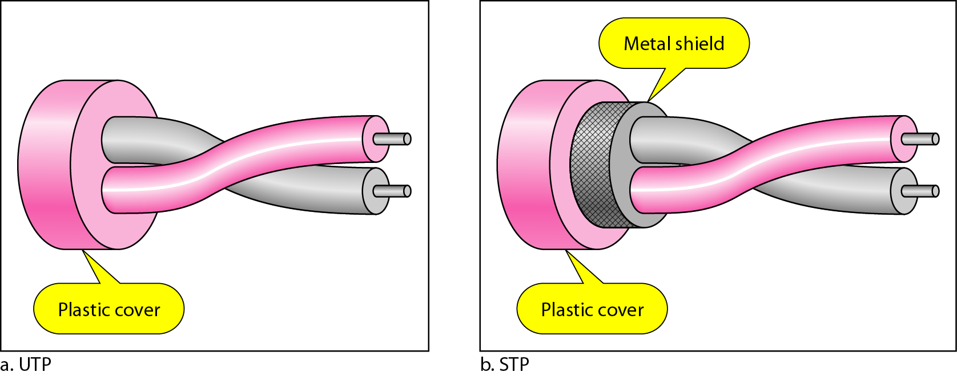
Twisted-Pair Cable

Slide 12
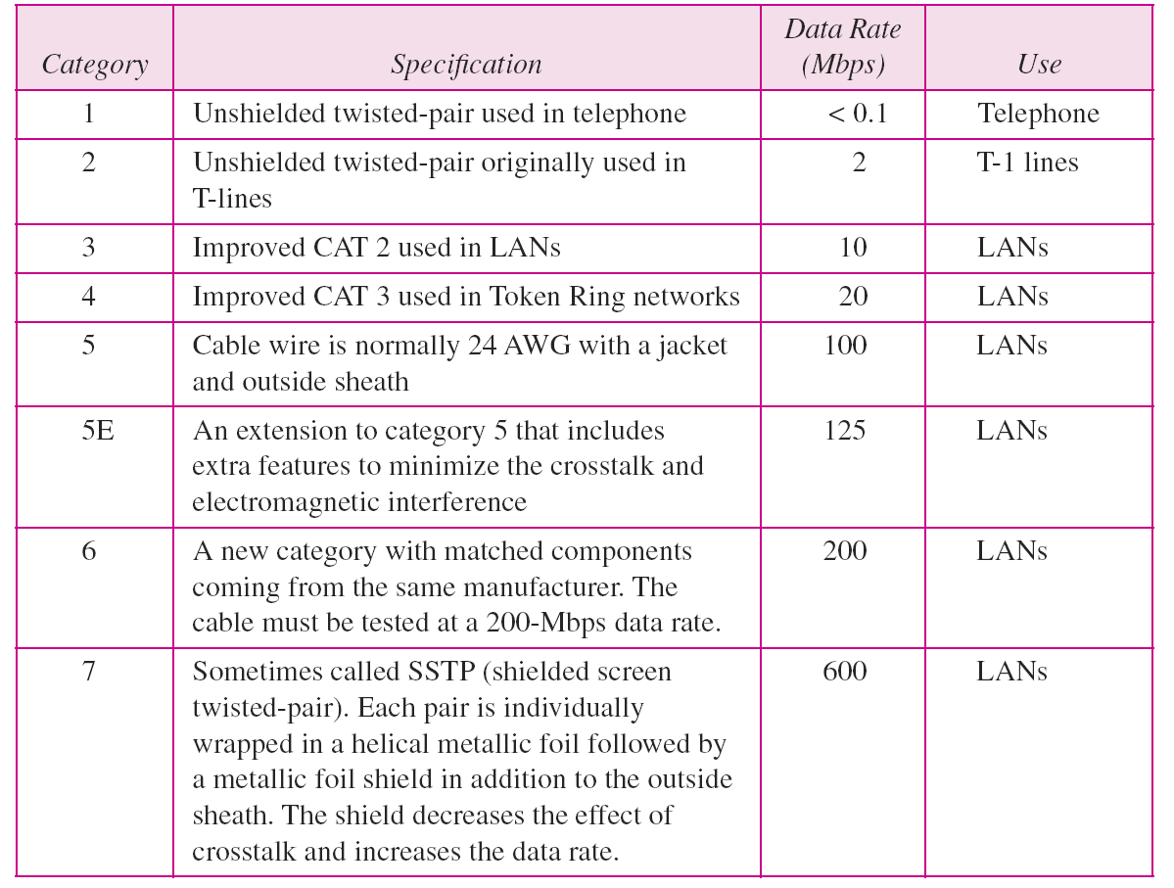
Categories of UTP
The Electronic Industries Association (EIA) has developed standards to classify UTP cable into seven categories.

Slide 13
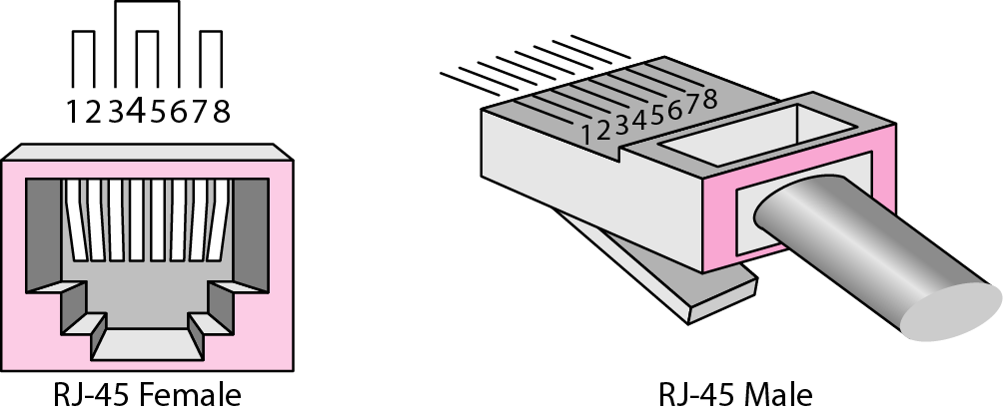
UTP Connector: RJ-45

Slide 14
Shielded Twisted-Pair Cable
Shielded twisted-pair (STP) provides better noise protection than UTP cabling.
Compared to UTP cable, STP cable is significantly more expensive and difficult to install.
Like UTP cable, STP uses an RJ-45 connector.
If the cable is improperly grounded, the shield may act like an antenna and pick up unwanted signals.

Slide 15
Types of STP

Slide 16
Coaxial Cable
Coaxial cable (or coax) carries signals of higher frequency ranges than those in twisted-pair cable.
Instead of having two wires, coax has a central core conductor of solid wire (usually copper) enclosed in an insulating sheath, which is, in turn, encased in an outer conductor of metal foil.
This outer conductor is also enclosed in an insulating sheath, and the whole cable is protected by a plastic cover.
Coaxial cables are categorized by their Radio Government (RG) ratings.
Each RG number denotes a unique set of physical specifications, including the wire gauge of the inner conductor, the thickness and type of the inner insulator, the construction of the shield, and the size and type of the outer casing.

Slide 17
Twisted Pair - Transmission Characteristics
Analog
  Amplifiers every 5km to 6km
Digital
  Use either analog or digital signals
  repeater every 2km or 3km
Limited distance
Limited bandwidth (1MHz)
Limited data rate (100MHz)
Susceptible to interference and noise

Slide 18
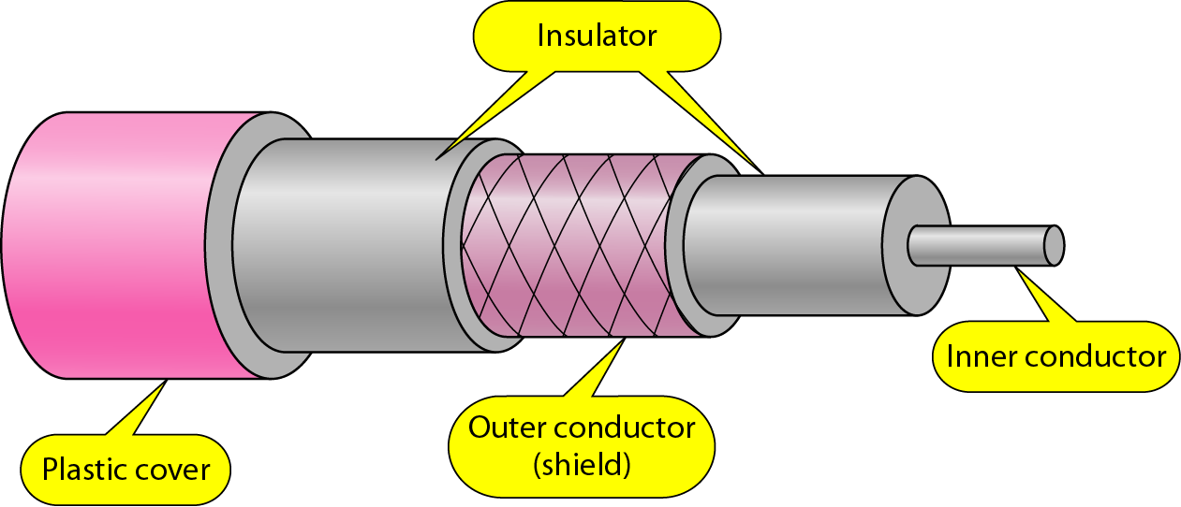
Coaxial Cable

Slide 19
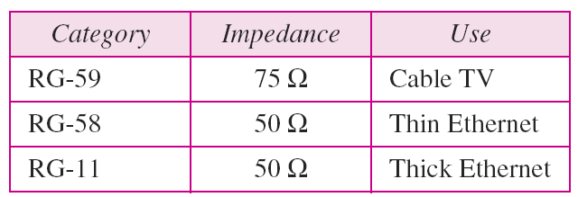
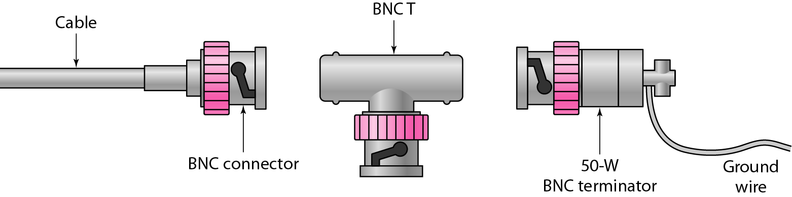
Coax Standards and Connectors
Bayonet Neill-Concelman (BNC)

Slide 20
Coax Cable - Transmission Characteristics
Analog
  Amplifiers every few km
  Closer if higher frequency
  Up to 500MHz
Digital
  Repeater every 1km
  Closer for higher data rates

Slide 21
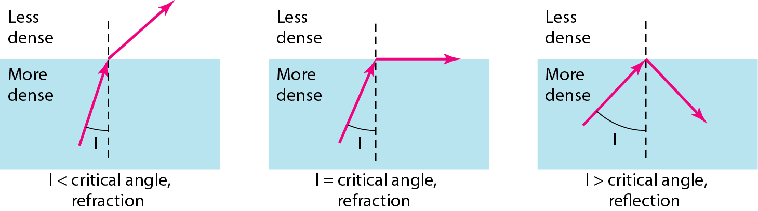
Fiber Optic Cable
A fiber-optic cable is made of glass or plastic and transmits signals in the form of light.
Light travels in a straight line as long as it is moving through a single uniform substance.
If a ray of light traveling through one substance suddenly enters another substance (of a different density), the ray changes direction.

Slide 22
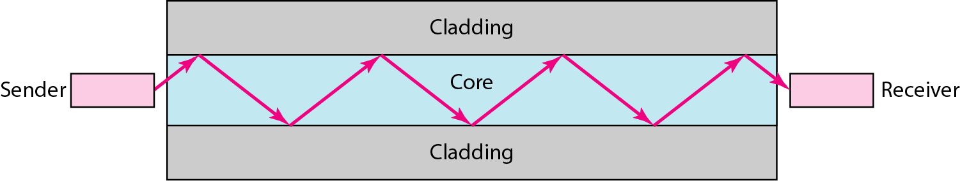
Fiber Optic Cable
Optical fibers use reflection to guide light through a channel. A glass or plastic core is surrounded by a cladding of less dense glass or plastic.
The difference in density of the two materials must be such that a beam of light moving through the core is reflected off the cladding instead of being refracted into it.

Slide 23
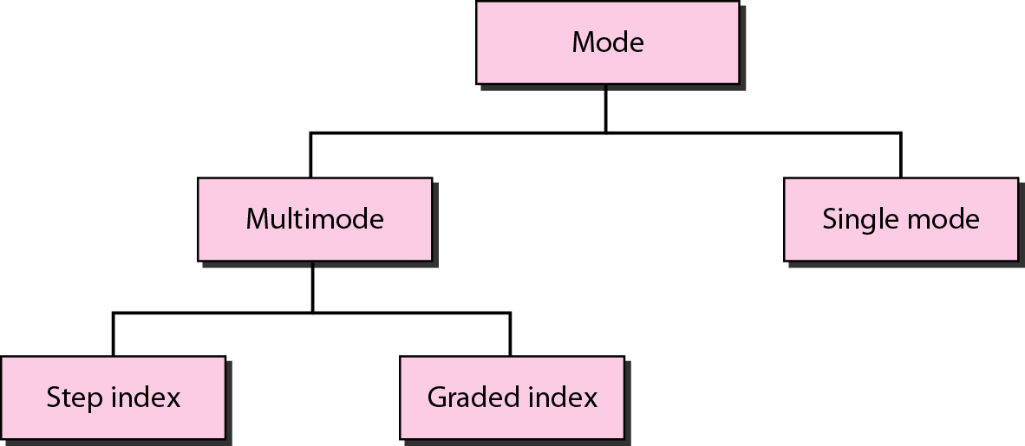
Propagation Modes: FO Cable
Current technology supports two modes (multimode and single mode) for propagating light along optical channels, each requiring fiber with different physical characteristics.

Slide 24
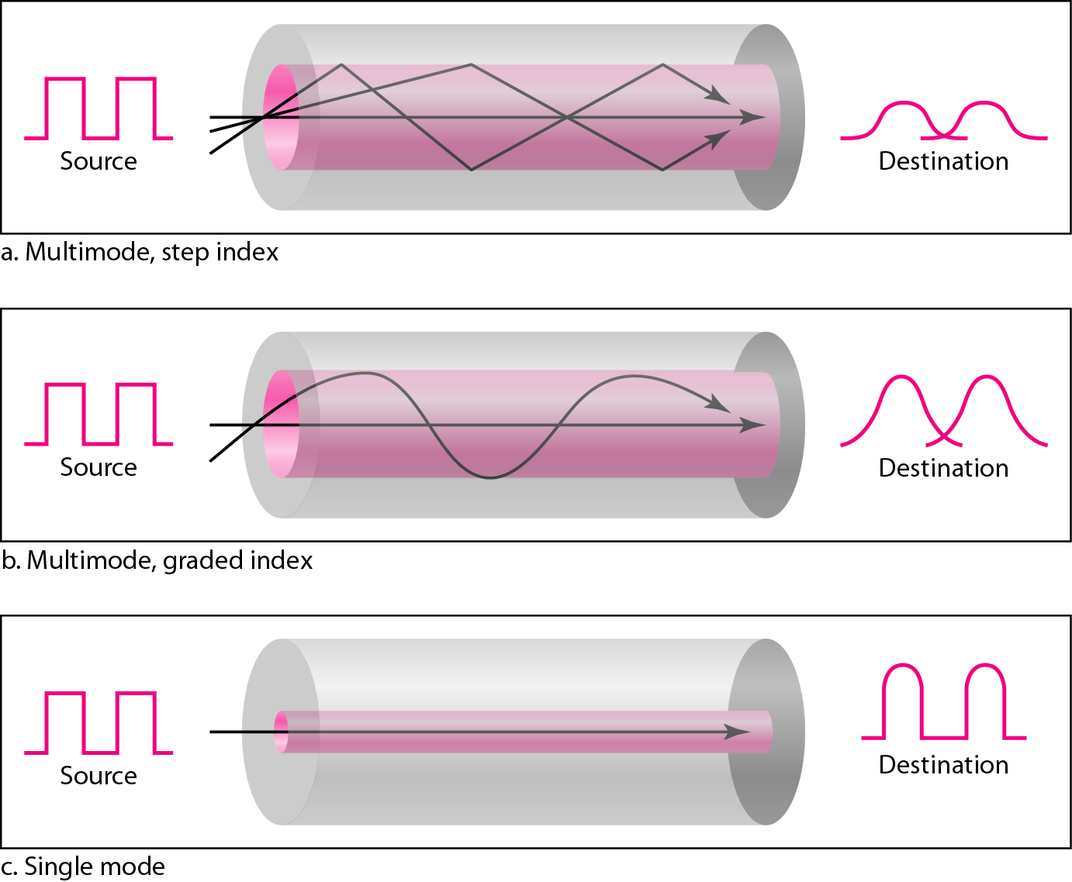
Propagation Modes: FO Cable
In multimode step-index fiber, the density of the core remains constant from the center to the edges.
A beam of light moves through this constant density in a straight line until it reaches the interface of the core and the cladding.
At the interface, there is an abrupt change due to a lower density; this alters the angle of the beam’s motion.

Slide 25
Propagation Modes: FO Cable
Multimode graded-index fiber, decreases this distortion of the signal through the cable.
Gradedindex fiber, is one with varying densities. High density at the center of the core and decreases gradually to its lowest at the edge.
Single-mode uses step-index fiber and a highly focused source of light that limits beams to a small range of angles, all close to the horizontal.

Slide 26
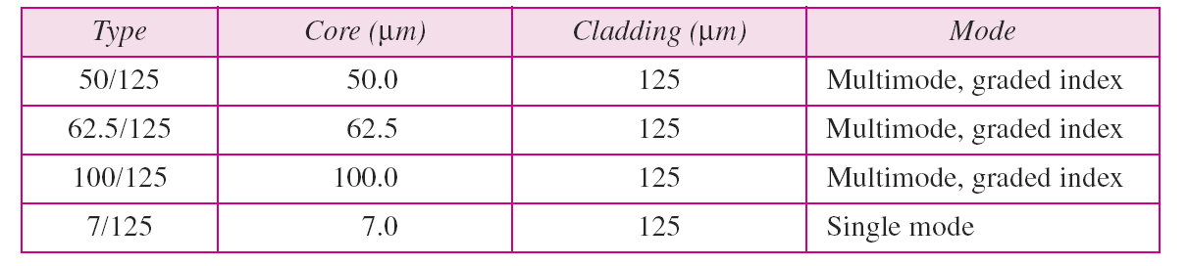
Fiber Types

Slide 27
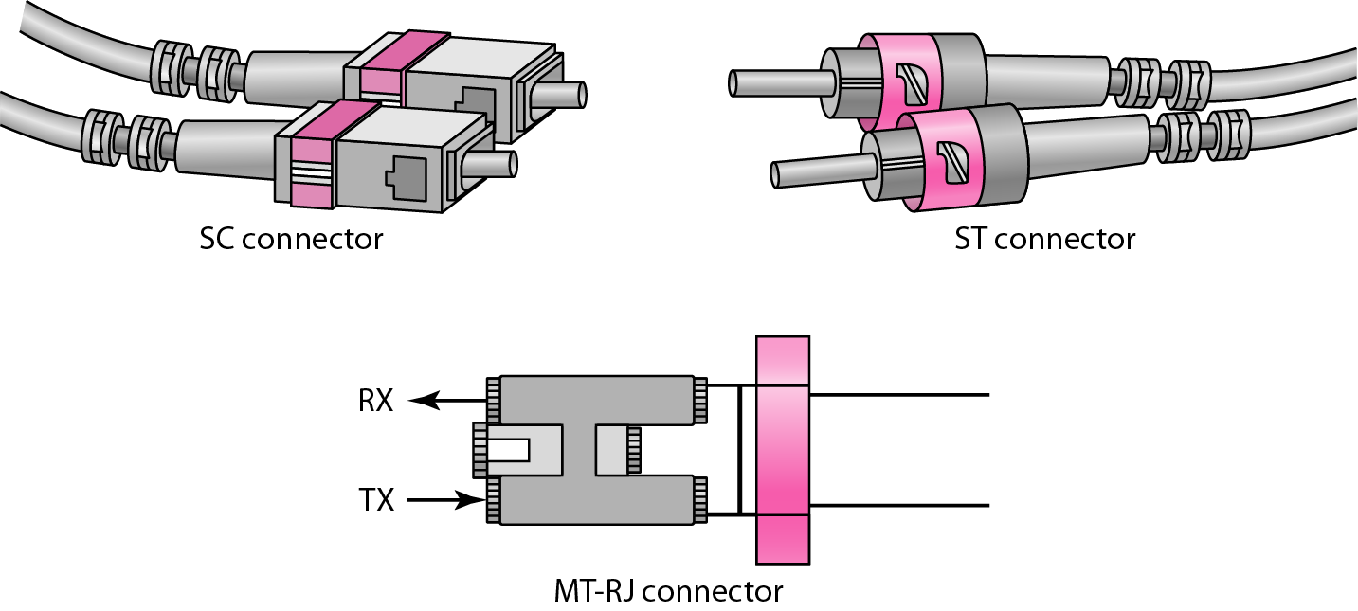
FO Connectors
Subscriber Channel (SC) connector
Mechanical Transfer Registered Jack (MT-RJ)
Straight-Tip (ST) connector

Slide 28
Pros and Cons of FO Cable
PROS
Higher bandwidth
Less signal attenuation
Immunity to electromagnetic interference
Resistance to corrosive materials
Light weight
Greater immunity to tapping
CONS
Installation and maintenance
Unidirectional light propagation
Cost

Slide 29
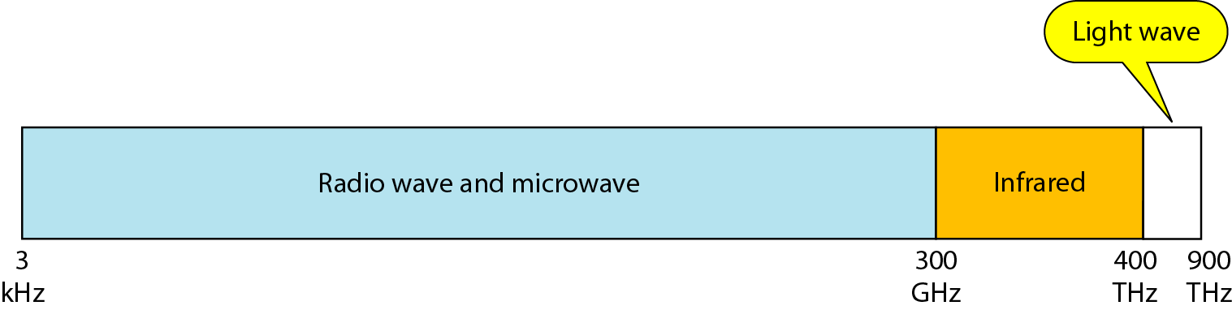
Unguided Media: Wireless
Unguided medium transport electromagnetic waves without using a physical conductor.
This type of communication is often referred to as wireless communication.
Signals are normally broadcast through free space and thus are available to anyone who has a device capable of receiving them.
The electromagnetic spectrum, ranging from 3 kHz to 900 THz, used for wireless communication.

Slide 30
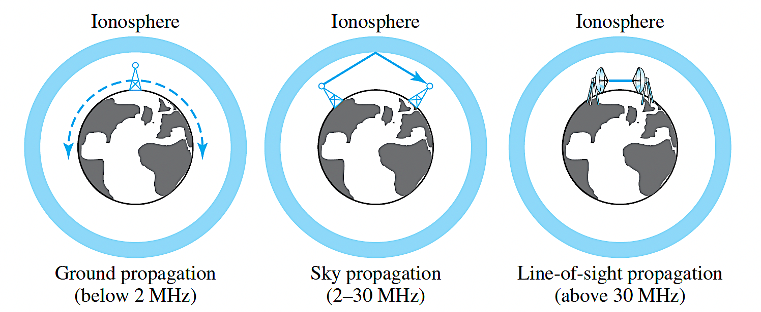
Unguided Media: Wireless
Unguided signals can travel from the source to the destination in several ways: ground propagation, sky propagation, and line-of-sight propagation.

Slide 31
Unguided Media: Wireless
In ground propagation, radio waves travel through the lowest portion of the atmosphere, hugging the earth.
These low-frequency signals emanate in all directions from the transmitting antenna and follow the curvature of the planet.
Distance depends on the amount of power in the signal: The greater the power, the greater the distance.
In sky propagation, higher-frequency radio waves radiate upward into the ionosphere where they are reflected back to earth.
This type of transmission allows for greater distances with lower output power.
In line-of-sight propagation, very high-frequency signals are transmitted in straight lines directly from antenna to antenna.

Slide 32
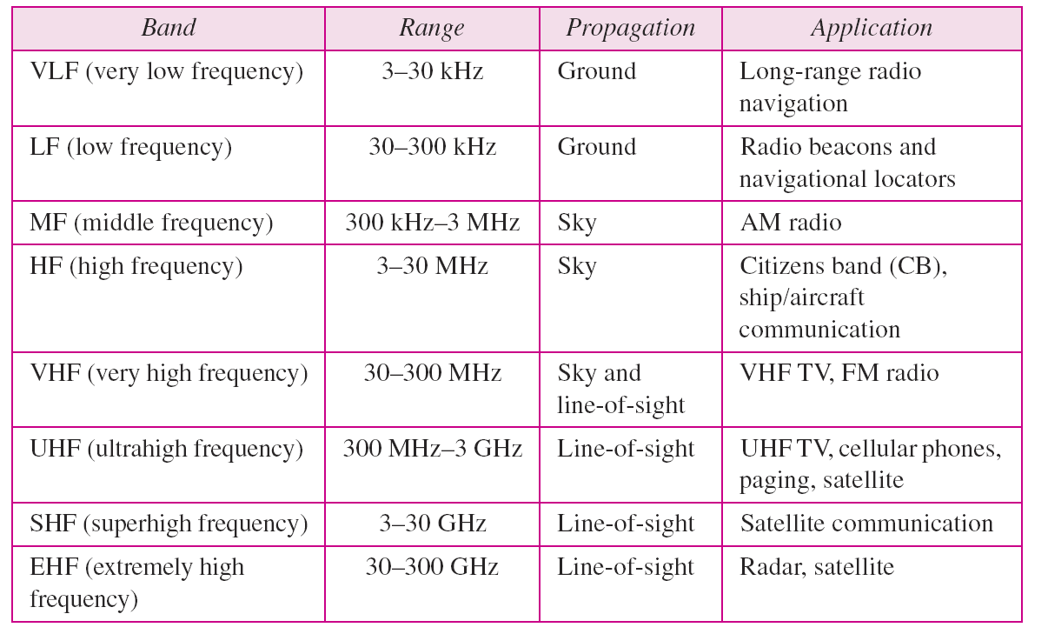
Unguided Media: Wireless

Slide 33
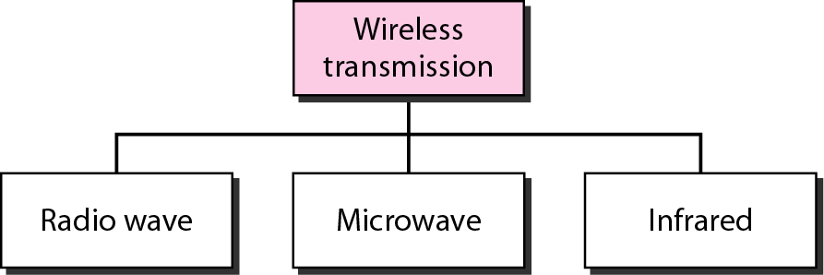
Unguided Media: Wireless

Slide 34
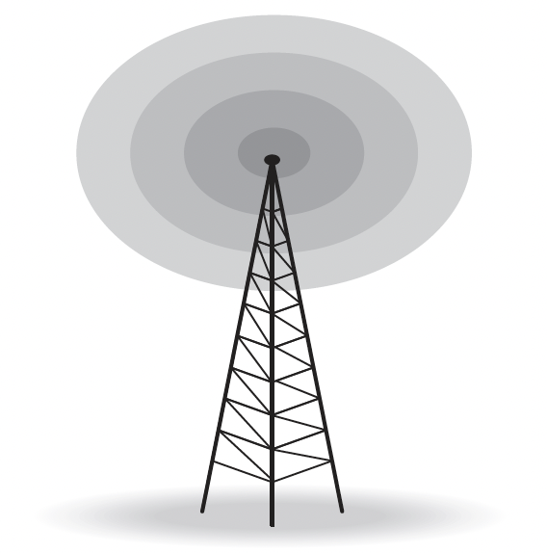
Radio Wave
Although there is no clear-cut demarcation between radio waves and microwaves.
Electromagnetic waves ranging in frequencies between 3 kHz and 1 GHz are normally called radio waves; waves ranging in frequencies between 1 and 300 GHz are called microwaves.
Radio waves are used for multicast communications, such as radio and television, and paging systems.
They can penetrate through walls. Highly regulated. Use omni directional antennas.
Radio waves, particularly those waves that propagate in the sky mode, can travel long distances. This makes radio waves a good candidate for long-distance broadcasting such as AM radio.

Slide 35
Microwaves
Electromagnetic waves having frequencies between 1 and 300 GHz are called microwaves.
Microwaves are unidirectional. When an antenna transmits microwaves, they can be narrowly focused. This means that the sending and receiving antennas need to be aligned.
A pair of antennas can be aligned without interfering with another pair of aligned antennas.
Very high-frequency microwaves cannot penetrate walls. This characteristic can be a disadvantage if receivers are inside buildings.
The microwave band is relatively wide, almost 299 GHz. Therefore wider subbands can be assigned, and a high data rate is possible.

Slide 36
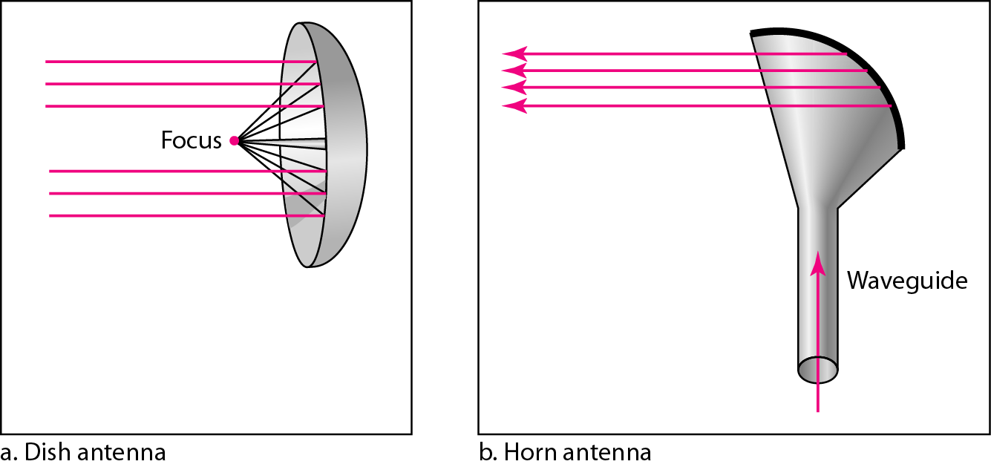
Microwaves

Slide 37

Microwaves
Infrared waves, with frequencies from 300 GHz to 400 THz (wavelengths from 1 mm to 770 nm), can be used for short-range communication.
Infrared waves, having high frequencies, cannot penetrate walls.
This advantageous characteristic prevents interference between one system and another.
In addition, we cannot use infrared waves outside a building because the sun’s rays contain infrared waves that can interfere with the communication.

